Slide 1
Sub-grid Scale Drivers of Pollution Inferred from Model-based Inference and Machine Learning
Eshani Patel, California Institute of Technology
Mentor: Yuliya Marchetti, Jet Propulsion Laboratory

Slide 2
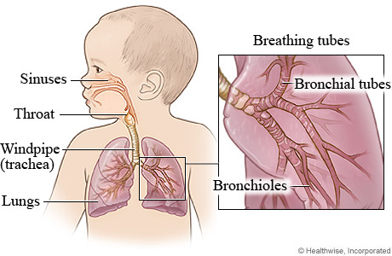
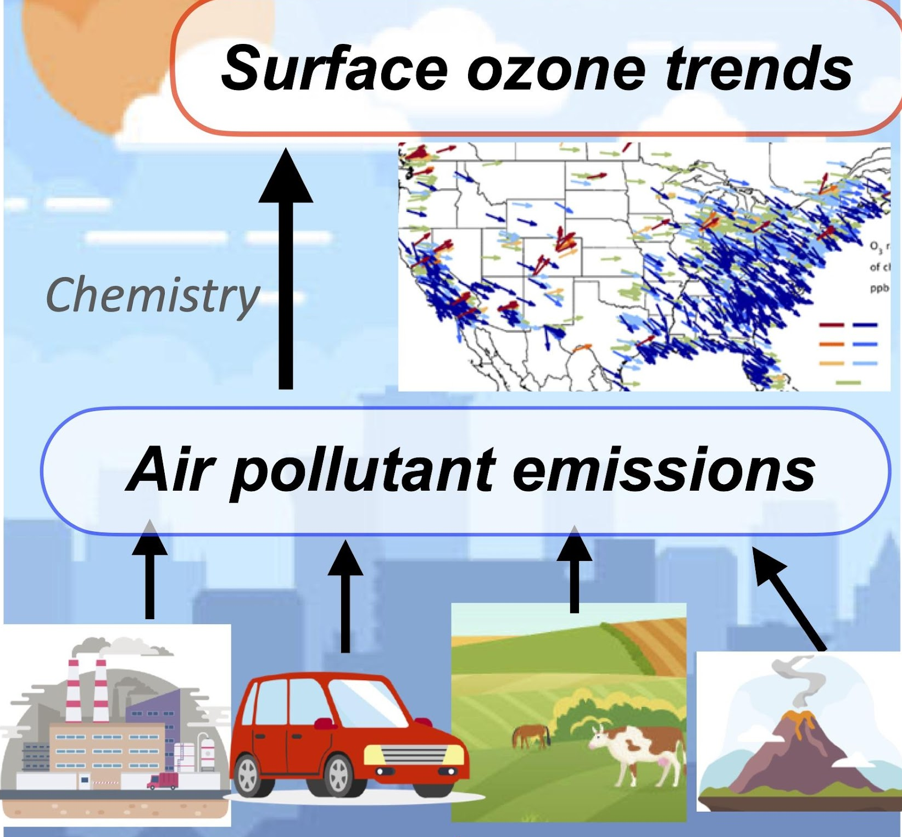
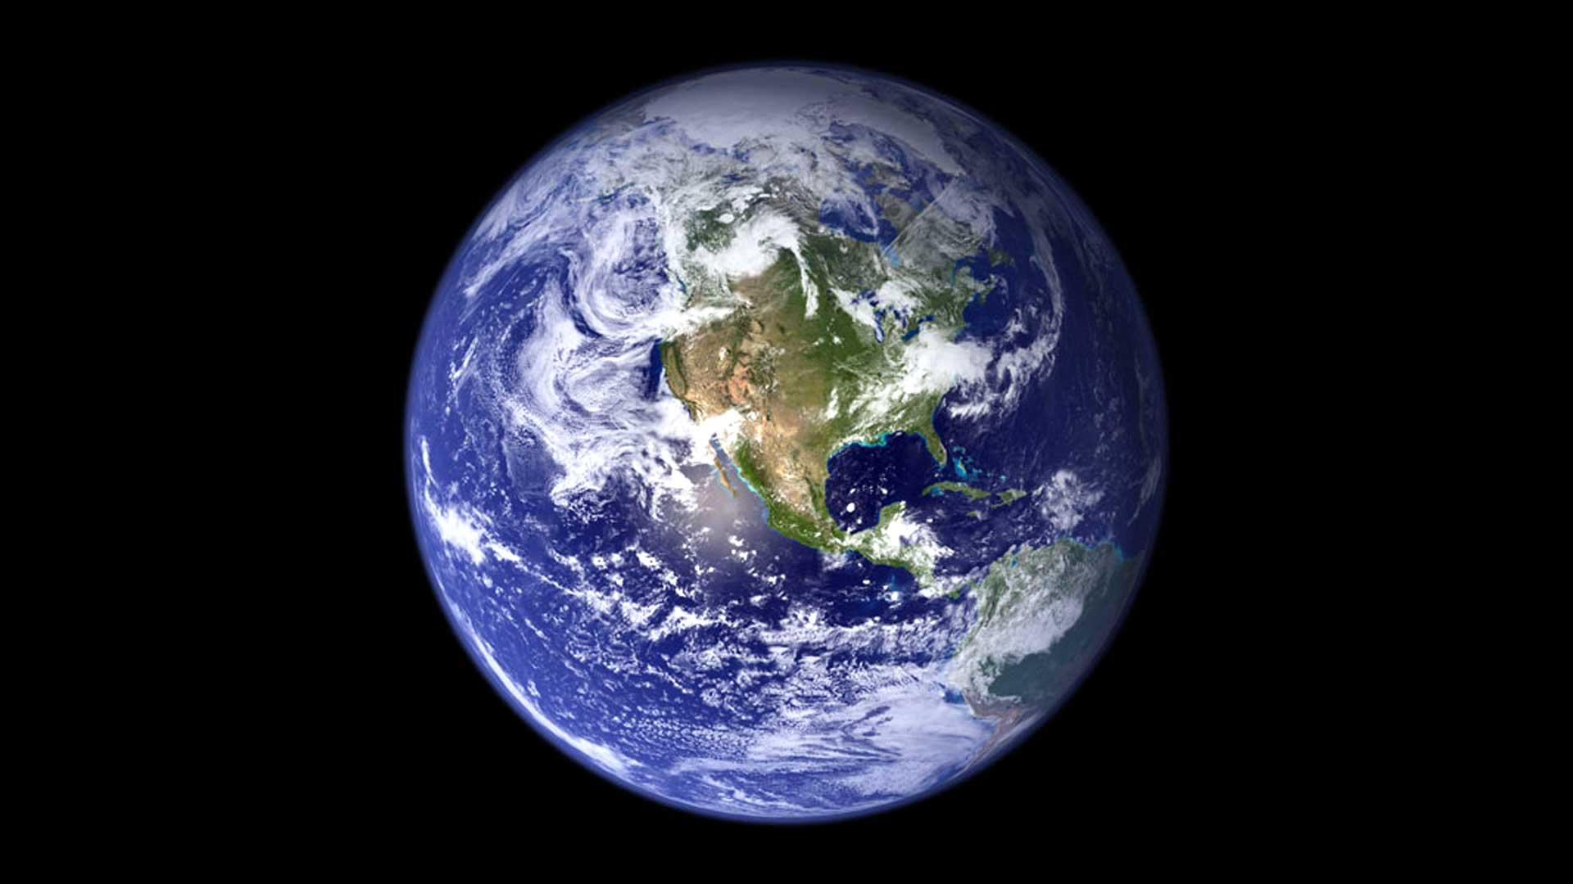
Driving Physical Science
> 8 M deaths
> 200 billion dollars
Human health
Climate

Slide 3
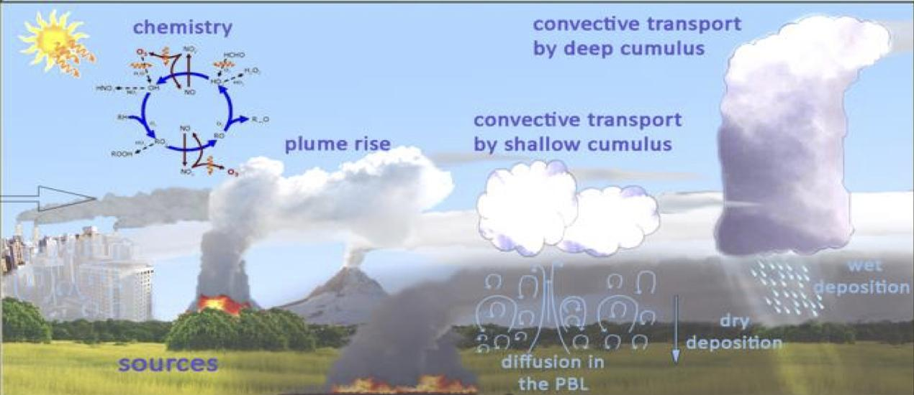
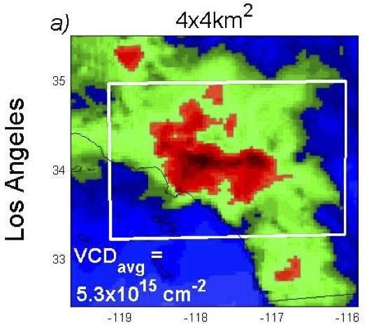
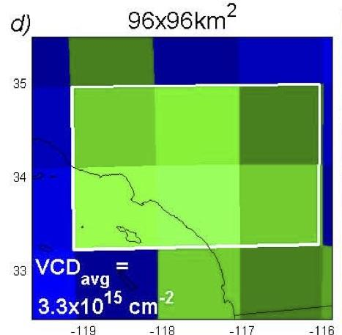
Driving Physical Science
2017 Earth Science Decadal Survey “Understanding the changes in air pollutants”
Air quality from satellite data and model predictions remains elusive goal
Air pollution model prediction biases (=systematic errors) can be largely driven by unresolved sub-grid scale processes
Air pollutant spatial gradients over LA
4 km resolution
100 km resolution
Chemistry
Planetary Boundary Layer (PBL) dynamics
−37 %
Model grid
Hypothesis 2: Strong spatial gradients in chemical regime coupled with PBL dynamics lead to bias patterns
Emissions
⭐
⭐
-------------------- Sub-grid scale --------------------
Hypothesis 1: Air pollution prediction biases are largely driven by non-linear sub-grid processes
JPL Quest: Understanding How the Earth Works as a System

Slide 4
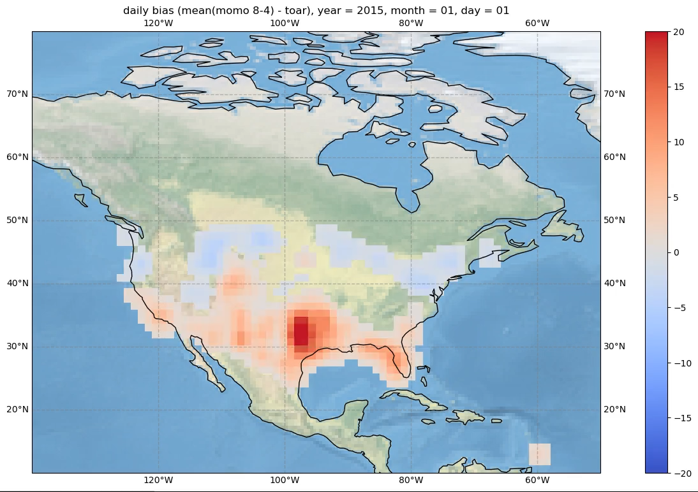
SUDS Air Quality
TOAR observed data
MOMO physical model
Use ML to:
Find drivers of bias in physical model
Find drivers of ozone prediction
Correct physical model accordingly
Ozone bias (mda8) for MOMO-chem over North America , 2015

Slide 5
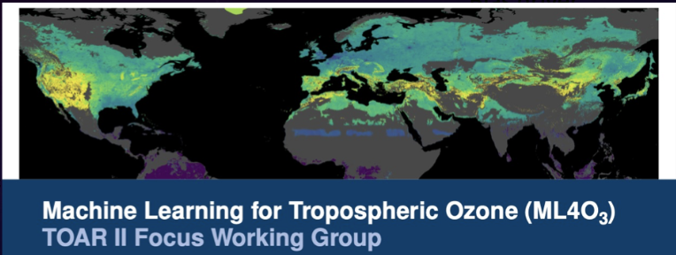
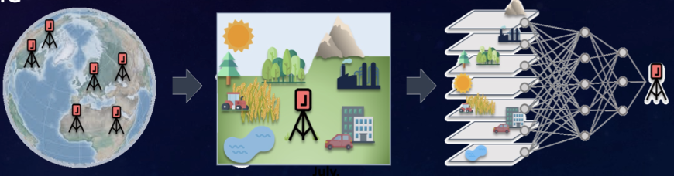
Benchmark dataset for community practice
AQ-Bench from IGAC TOAR-2:
Collaboration with the international cummunity
Compiled dataset for a limited time period an set of drivers:
>20 parameters
Driver selection and analysis
Simplet data to test our ML framework
Baseline to compare with other studies

Slide 6
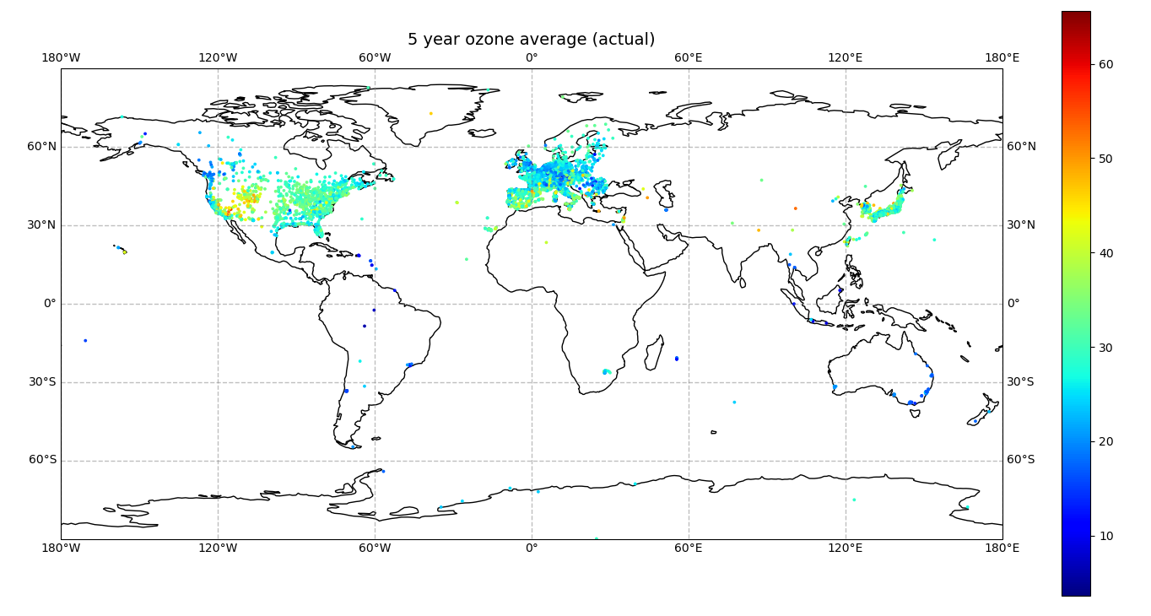
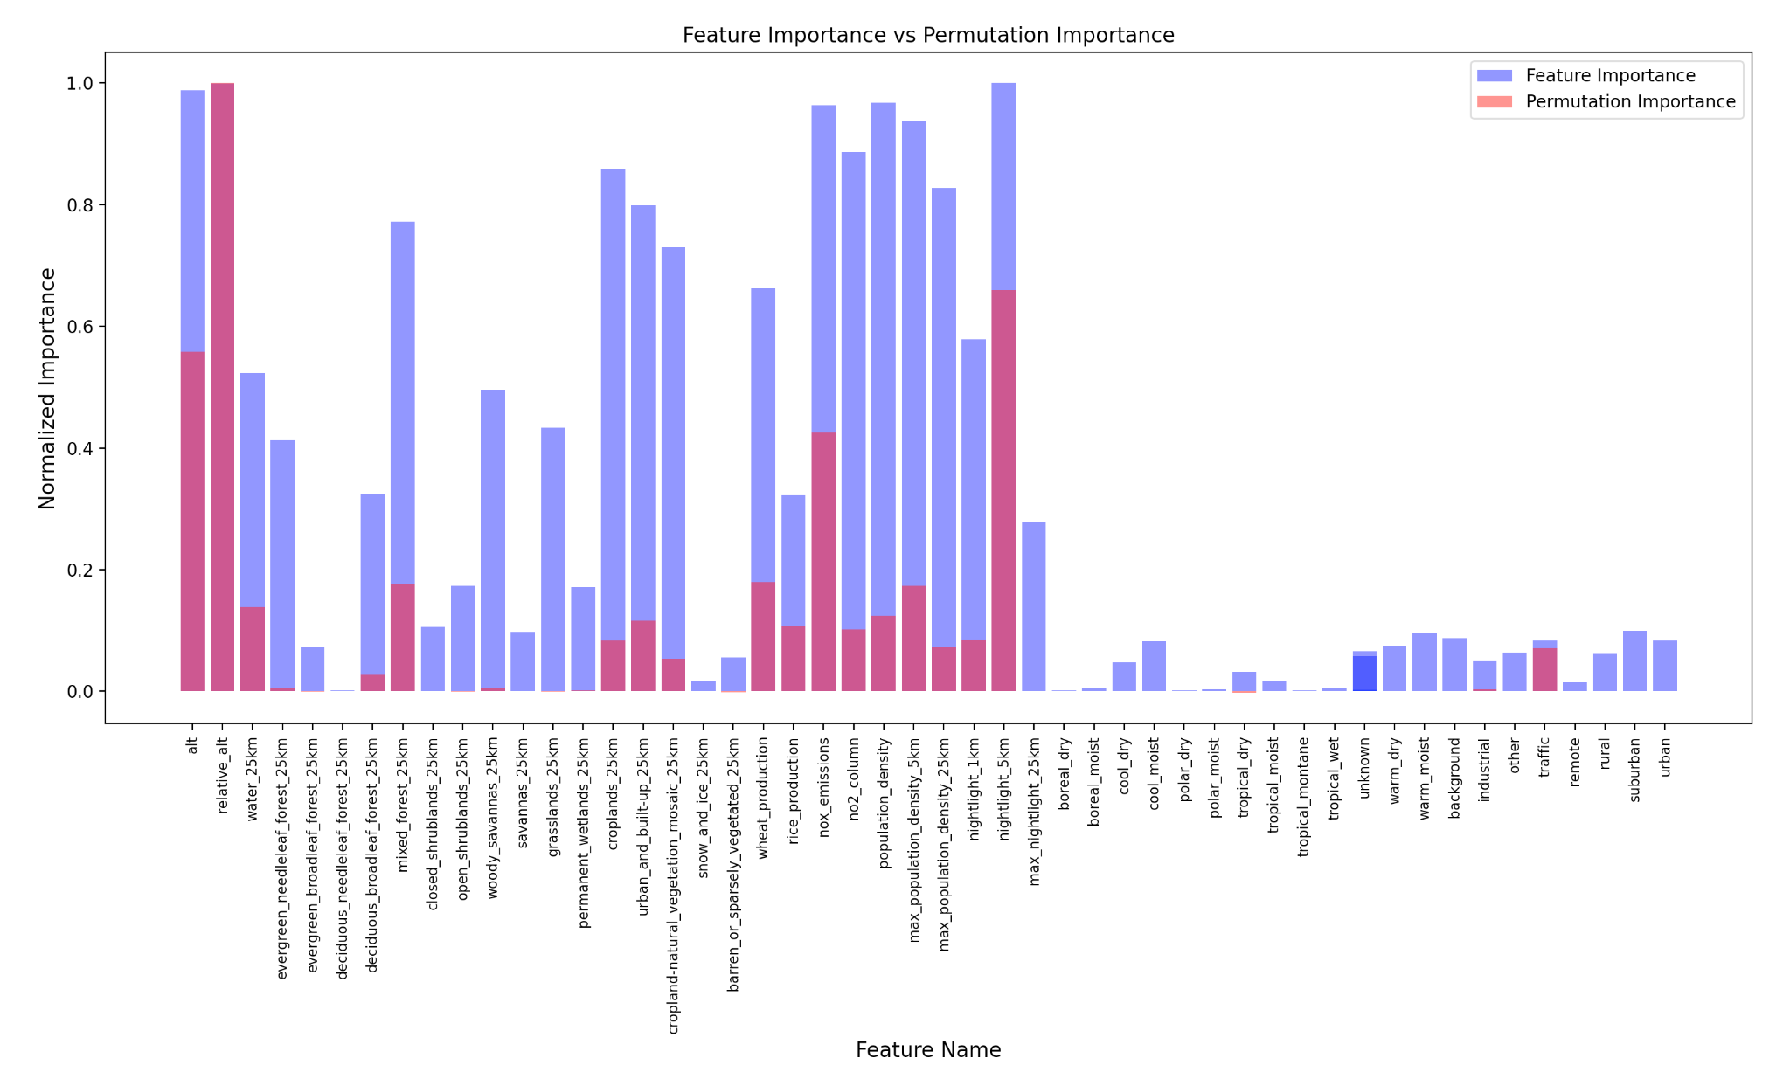
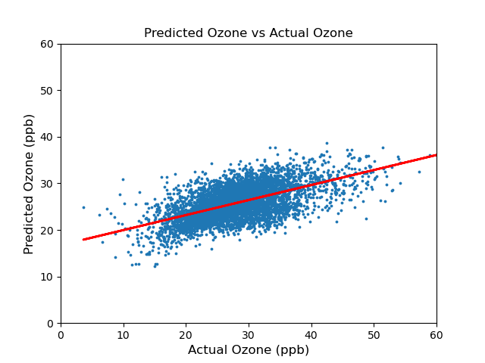
Machine Learning with AQ-Bench
Random Forest ML Model
RMSE: 5.61
R-correlation: 0.59
Extracted feature importance and permutation importance
Split ML model regionally to study North America and Europe
Calculated bias from MOMO

Slide 7
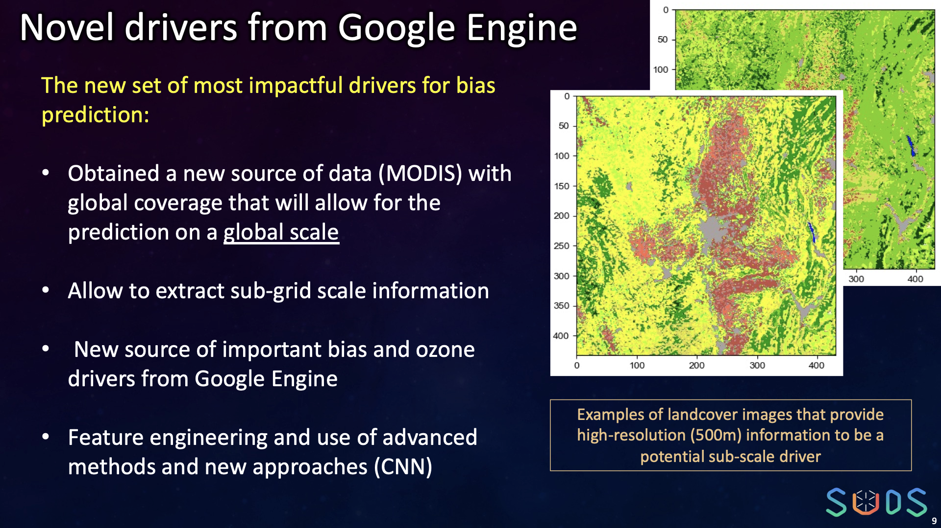


Slide 8
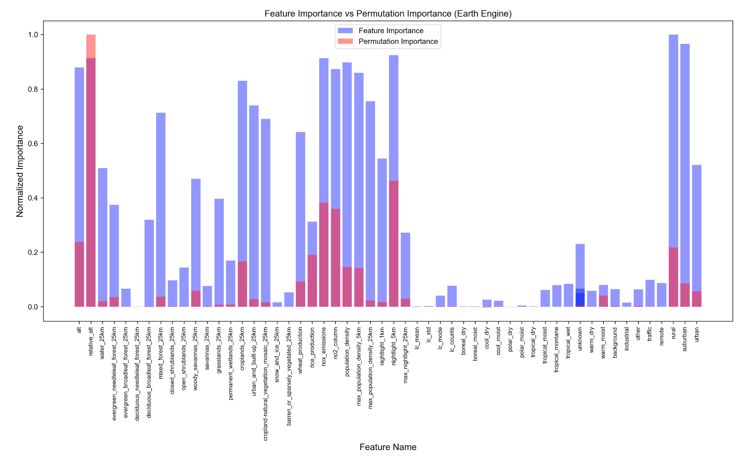
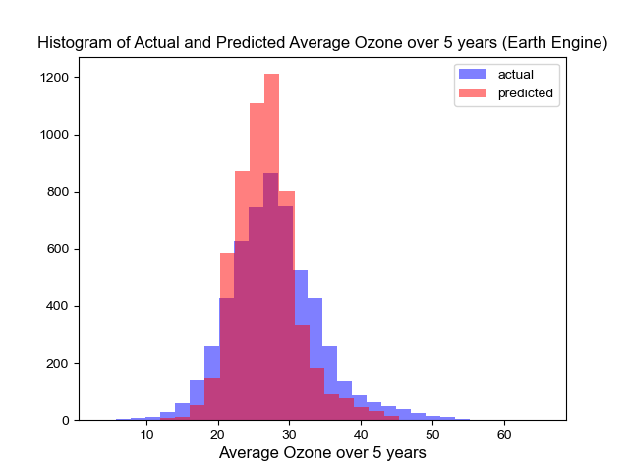
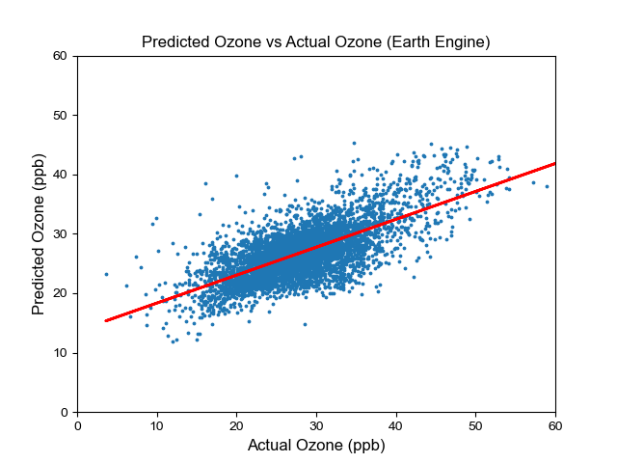
Feature Engineering of MODIS Images
Feature engineering with Land Cover Type 1
50 km images around each TOAR station
Extracted 4 new features:
Mean
Standard deviation
Number of land cover types
Mode
RMSE = 4.67
R-correlation = 0.69
Improved model/benchmark

Slide 9
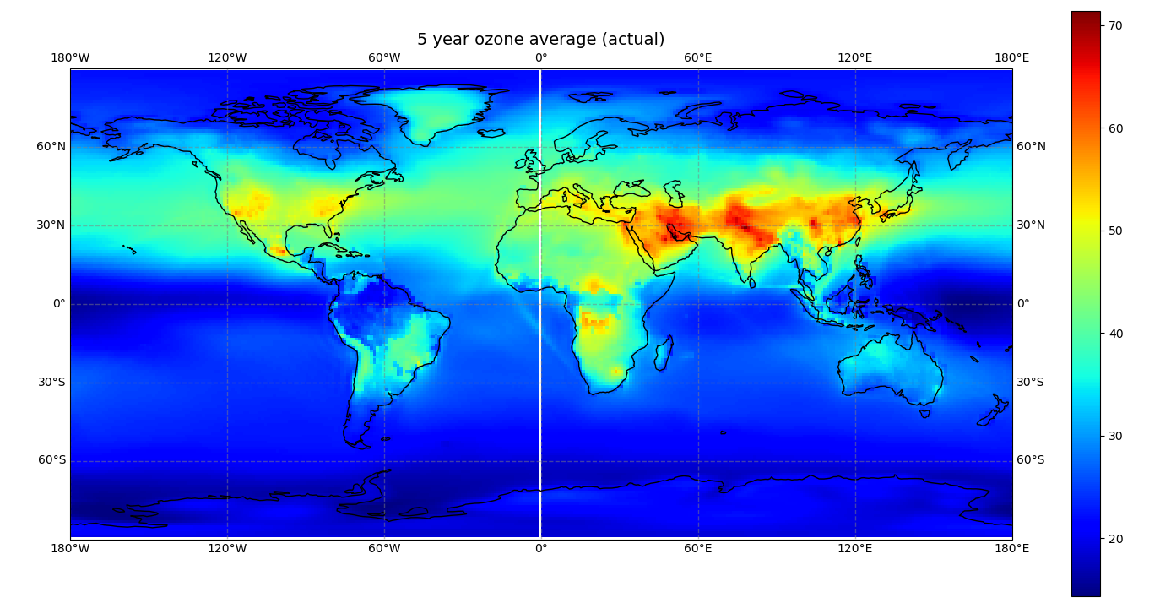
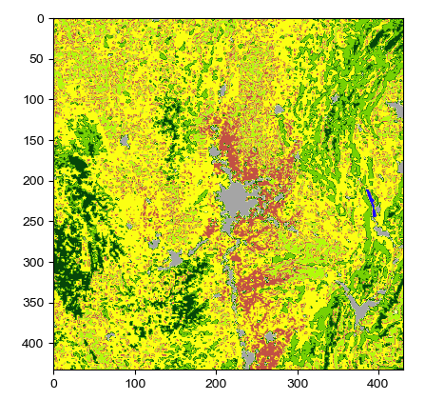
Conclusions
First time working with ML and on a data analysis task
Future goals:
Expand model with bigger datasets
Continue work with Earth Engine

